Slide 1
Welcome to DSPE

Slide 2
Dutch Society of Precision Engineering, DSPE
By Engineers for Engineers
Independent professional branch organization since 1954 for all precision engineers in the Netherlands and surrounding countries
community of precision engineers stimulating professional contact and sharing knowledge and experience
More than 150 member organizations active in precision engineering
Activities: Conferences, Lectures, workshops and education
Attracting young precision professionals
https://www.dspe.nl

Slide 3
Dutch Society of Precision Engineering, activities
Conference on Precision Mechatronics
Optomechatronics symposium
Young DSPE (Company visits, Café Eureka, Whatsapp)
Awards
Educational program
Design Principles for Precision Mechatronics
Thermomechanics
Mikroniek
Website
Knowledge days
MSKE/ MCG contactgroups
Lunchmeetings
https://www.dspe.nl

Slide 4

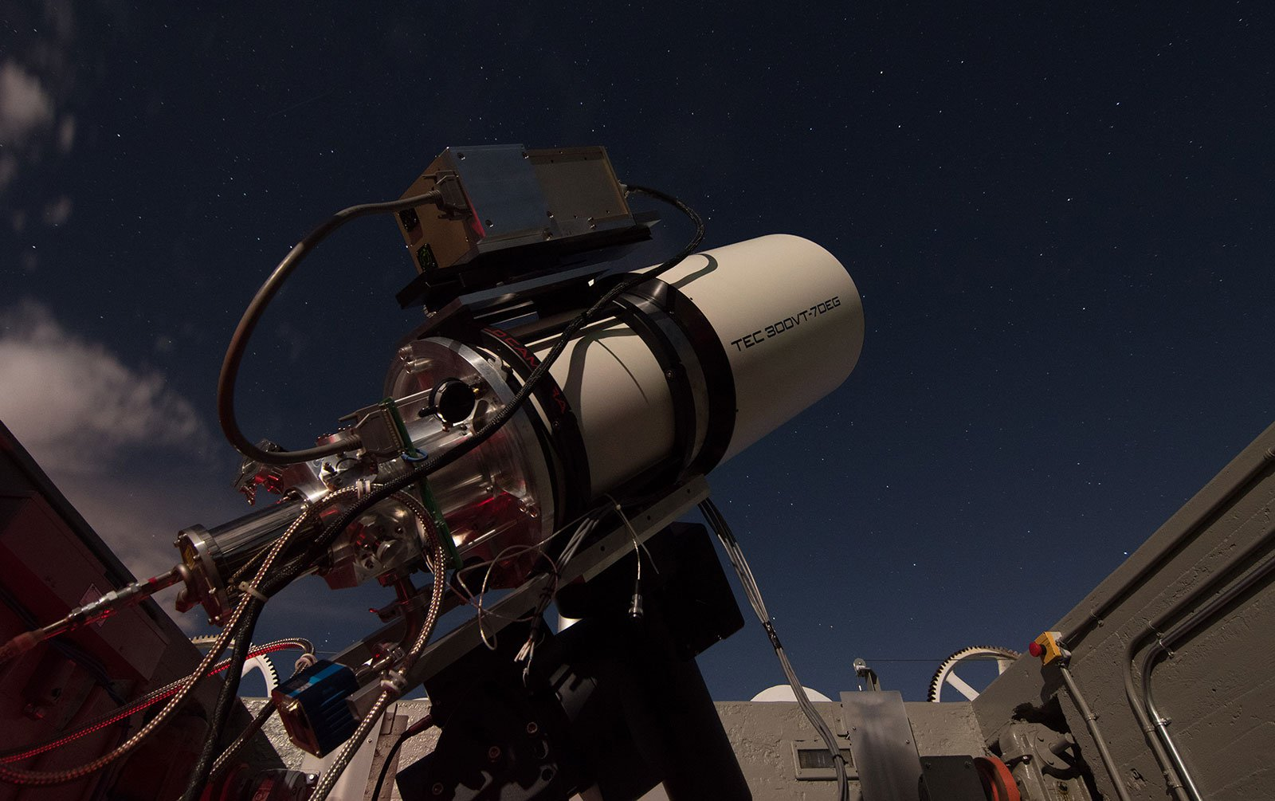
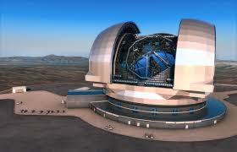
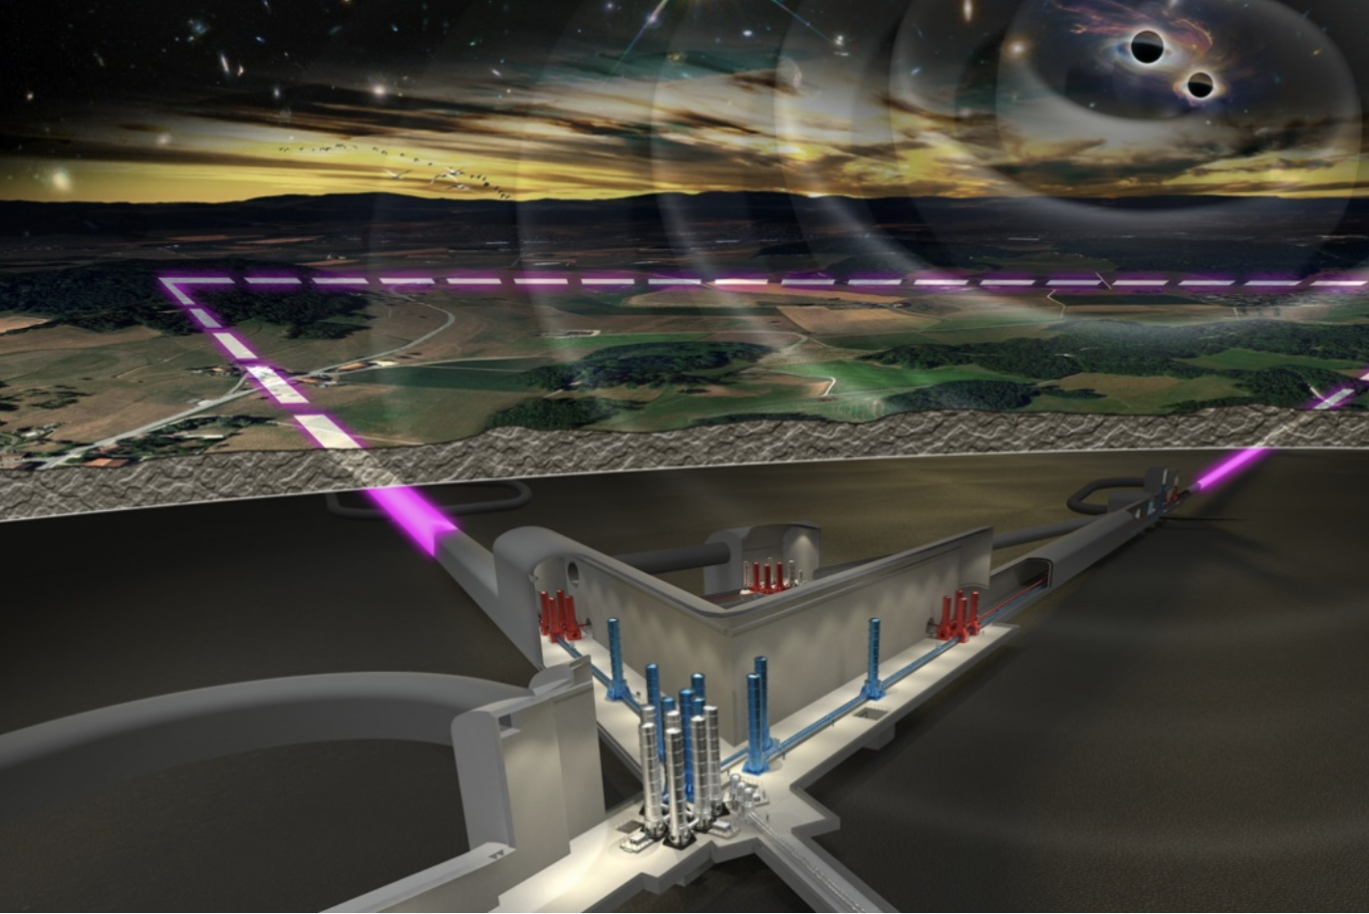
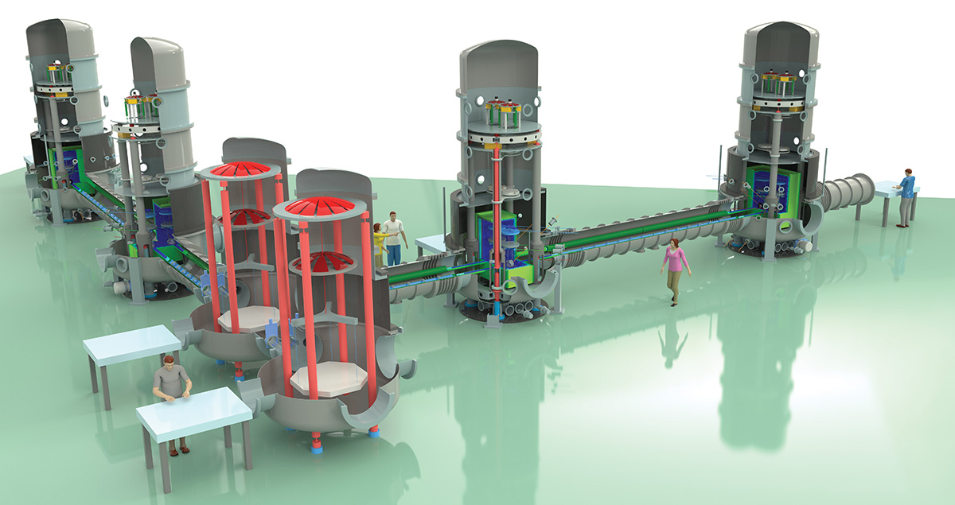
Conferences / Events
Conference on Precision Mechatronics, 2 day’s, bi-yearly
Opto-Mechatronics symposium, 1 day, bi-yearly
Gasbearing workshop
  The Gas Bearing Workshop (2027) is a cooperation of the Dutch Society for Precision Engineering (DSPE) and the VDE VDI Society for Microelectronics, Microsystems and Precision Engineering GMM.
October 8, 2026
The Opto-mechatronics of telescopes: From tiny too extremely large

Slide 5

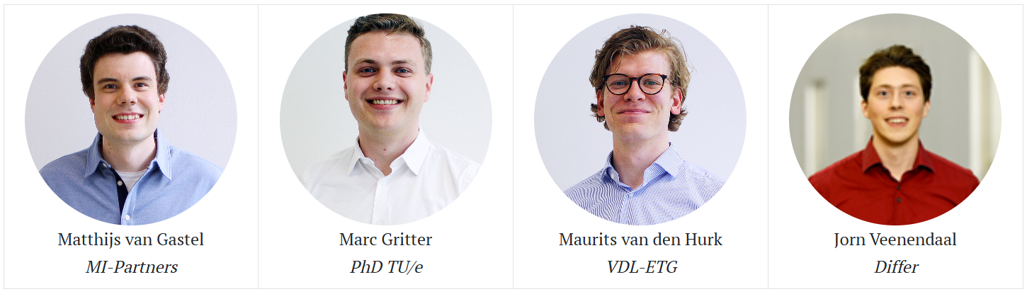
Young DSPE
The Young DSPE promotes Precision Engineering and metrology under engineers
Our events, including visits to companies active in precision technology, target young professionals and students. This creates a vibrant and enthusiastic atmosphere.
Visits combine interesting talks, typically high-level talks about recent technological developments, with a visit to a test-facility or work floor.
Café Eureka
Participation is free of charge and open to all engineers working in precision technology, as well as students.
Young DSPE Boardmembers

Slide 6

Awards
Wim van der Hoek award
To the best graduation work
Rien Koster award
The works of an expert, active for many years in precision engineering
Ir. A. Davidson award
To encourage young talent
Martin van den Brink award
For the best contributor in precision engineering from both system architecture and business development perspective.
Students
Oeuvre
Promising engineer
System Engineer with Impact
Yearly
Every 2 years
Every 2 years
Every 3 years

Slide 7


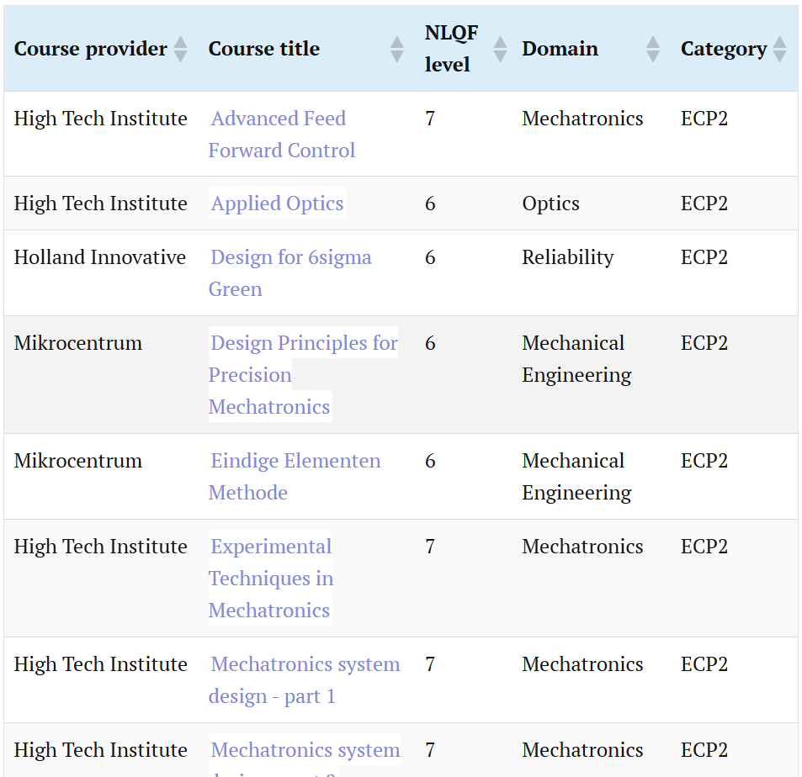
Certified Precision Engineer
The Dutch Society for Precision Engineering (DSPE) has selected and qualified the best post-academic and other levels courses for precision engineers.
CPE enlarged by Microcredentials, the digital diploma storage system:
Targeted Learning:
Flexible and Accessible
Stackable
Industry-Relevant
Recognition
Covering majority of professional courses for precision engineers
Claiming the Microcredentials:
You as a graduate can receive your microcredential from DSPE through a claiming page which presents your credential to you in an email.
DSPE organizes the Opto-Mechatronics System Design course (twice a year)

Slide 8
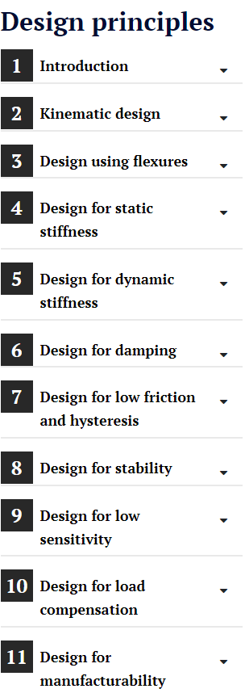

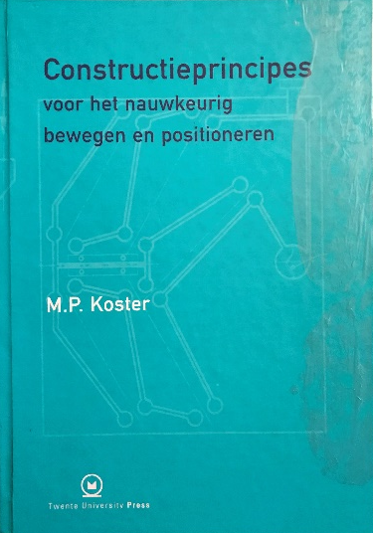
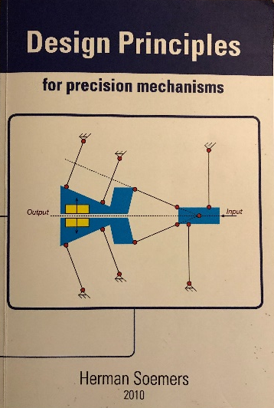
Design Principles for Precision Mechatronics (DPPM)
Design Principles for Precision Mechatronics. A collection of applications categorized in themes known from construction principles.
A new update on the DDP (“ Des Duivels Prentenboek”) of Wim van der Hoek
A book and a website containing examples of precision mechatronics elements. DSPE members can contribute by writing clear examples to be freely used.
DPPM
Van der Hoek
Koster
Soemers

Slide 9
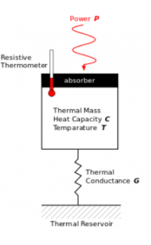
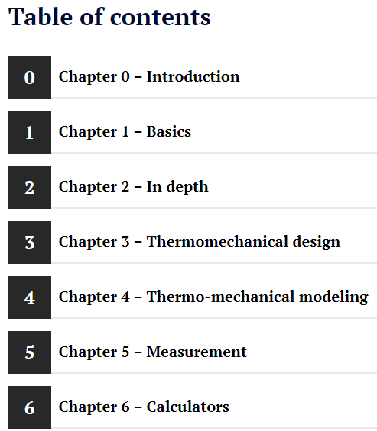
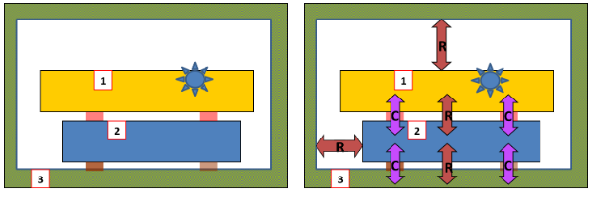
Thermomechanics
The DSPE, together with thermomechanical engineers, have taken the initiative to create a dedicated website.
The purpose is to give an introduction to thermomechanics for precision engineers.
A starting point for mechanical engineers for knowledge how to solve thermomechanical problems
Get an understanding how thermomechanics affects a mechanical design.
List of calculators:
    LUMP MASS MODEL – STEADY STATE
    LUMP MASS MODEL – TRANSIENT
    RADIATION
    GAS CONDUCTION
    THERMAL DEFORMATION

Slide 10
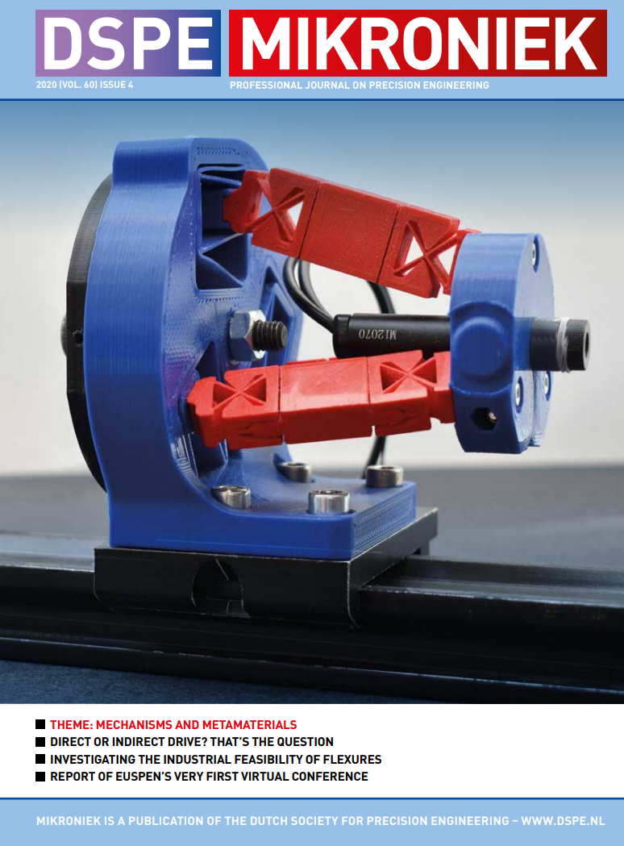
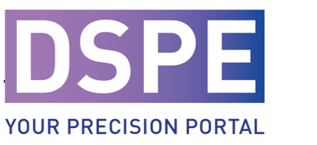
Mikroniek
By Engineers for Engineers
Members: 150 industries and organizations
Our activities:
Media
“Mikroniek” Magazine for Mechatronic Engineer
Website with content Knowledge - DSPE
  Mikroniek database
Available in paper and digital version

Slide 11
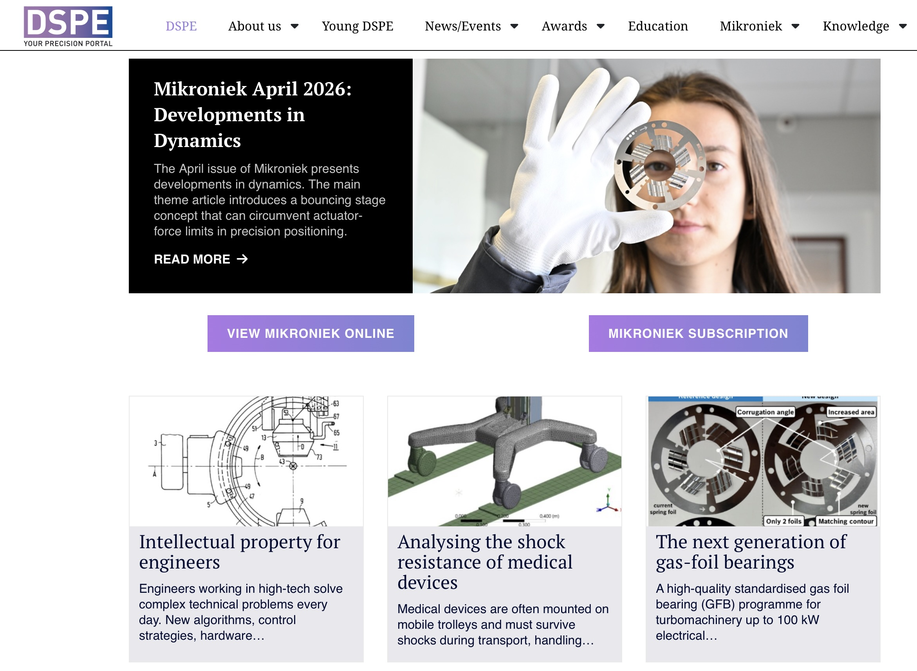
Website
2000 unique visitors per month
Mikroniek content (> 1 year old)
Events
DPPM
Thermomechanics
Education
General DSPE information

Slide 12
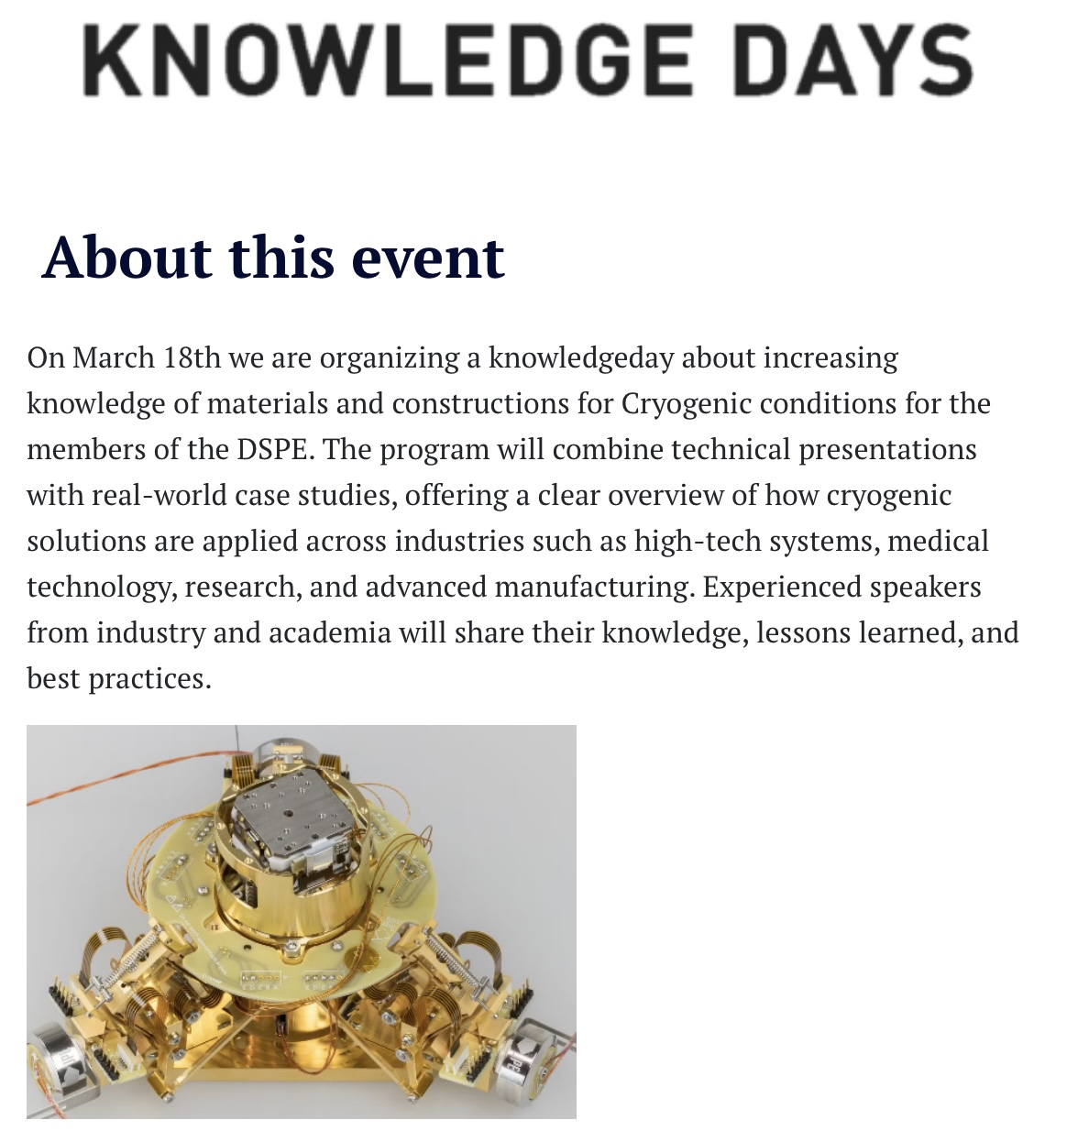
Knowledge days
By Engineers for Engineers
50-80 visitors
Twice a year
Highly appreciated
Contamination
Cryogenic
Vacuum

Slide 13
MSKE/ MCG contactgroups
x

Slide 14
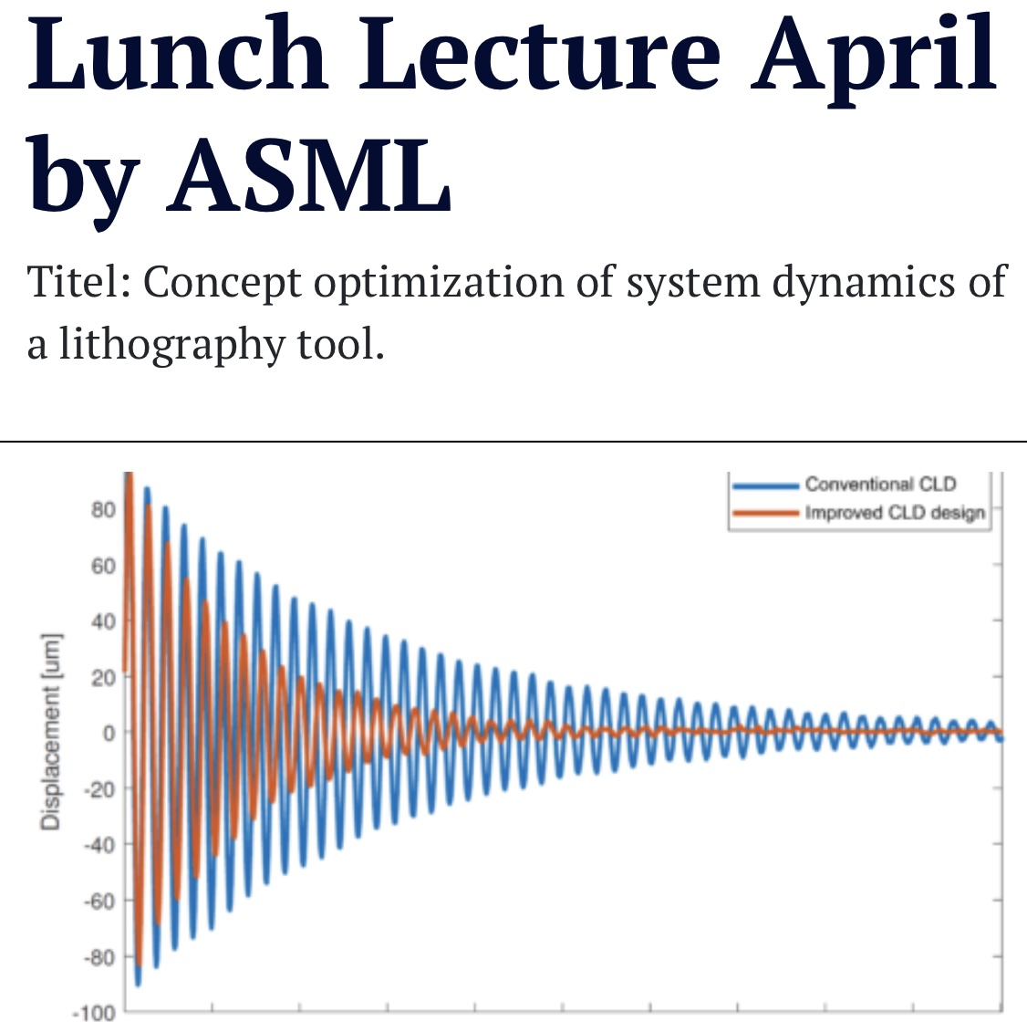
Lunchmeetings
Every Monday of the month
Just after the air raid siren at 12.02 hr
Digital meeting via MSteams
Around 100+ participants
Initiated during Corona period when physical meeting was not possible
Technical presentation

Slide 15


Current focus areas
Young professionals
Education program (microcredentials)
System Engineering
Artificial Intelligence

Slide 16
Enjoy DSPE's activities

